Slide 1
Assessment
Review and Design for
Student Learning Outcomes

Slide 2
Before we begin…
Find your work group – it’s important where you sit. Try to sit with members of your school or district.
On the wall you will see a chart that will be used to capture everyone’s level of comfort and knowledge with using a formal process for reviewing assessments. Place a dot on the chart the best represents your level of comfort and knowledge currently.
High Knowledge
Next
Low Knowledge
Low Comfort
High Comfort
Notes:
All same color dot

Slide 3
Workshop Objectives:
Desired Outcomes
Why am I here?
To develop a process for “Seeking to ensure that assessments used for educator effectiveness are Fair, Valid, and Reliable”
To gain a clear understanding of how to use the Assessment Review Tool
Understand how this work supports teachers and STUDENTS!
Notes:
During today’s sessions, we hope that you will:
Gain a clear understanding of the requirements set in SB 10-191 for student learning outcomes/student growth
Understand the shift from student growth to student learning outcomes; student growth is still our focus, not achievement, per se, but it becomes embodied in student learning outcomes
Be able to use the Assessment Review Tool (ART) to help validate assessments and provide feedback for improvement
You’re role is critically important… you have the opportunity to set the mood of how these changes are being implemented in your district/school. The words you choose matter. As you are training on the six steps of the new evaluation system, you are also establishing the importance and purpose of what this change in evaluation is all about. Also, you want to be able to inform the 1338 and/or District Accountability Committees (DAC) about the process for determining a rating for Student Learning Outcomes.
These key themes help to ease fears and ensure that your teachers know that this work is being done in a way that is fair and supportive of their ongoing professional growth.

Slide 4
STATE COUNCIL FOR EDUCATOR EFFECTIVENESS
Framework for System to Evaluate Teachers
Definition of Teacher Effectiveness
Quality Standards
I. Know Content
II. Establish Environment
III. Facilitate Learning
IV. Reflect on Practice
V. Demonstrate Leadership
VI. Student Growth
50% Professional Practice Standards 50% Student Growth Measures
Observations of Other Measures Teaching Aligned with
CDE Guidelines
Weighting: How Much Does Each Standard Count Towards Overall Performance?
State Other Assessments Other Measures
Summative for Non-tested Aligned with Assessments Areas CDE Guidelines
Match of test to teaching assignments
Weighting:
Scoring Framework: How Do Measures of Quality Standards
Result in a Determination of Individual Performance?
Performance Ratings
Ineffective Partially Effective Effective Highly Effective
Appeals Process

Slide 5
Educator Effectiveness Model
SPF – Collective, Statewide Summative, & Colorado Growth Model
Grade/Content Decided – Individual
2013-2014 School year: State or nationally normed assessments (TCAP, ACT, iReady, DRA2, etc.)
2014-2015 School Year: Content developed assessments as long as the protocol is followed and it passes the CDE review tool.
Professional Practice 50%

Slide 6
Assessment Proposal
Contents:
Default list for content or grade detailing the assessment used for each course/grade
The following for each course or grade
  Content assessment List for individual attribution
  Assessment Data Summary
  Assessment
  Report from Assessment Review Tool
  Teacher Directions
  Scoring Criteria: Guide or rubric
  Master Scored Items
*repeat a-g for each course/grade

Slide 7
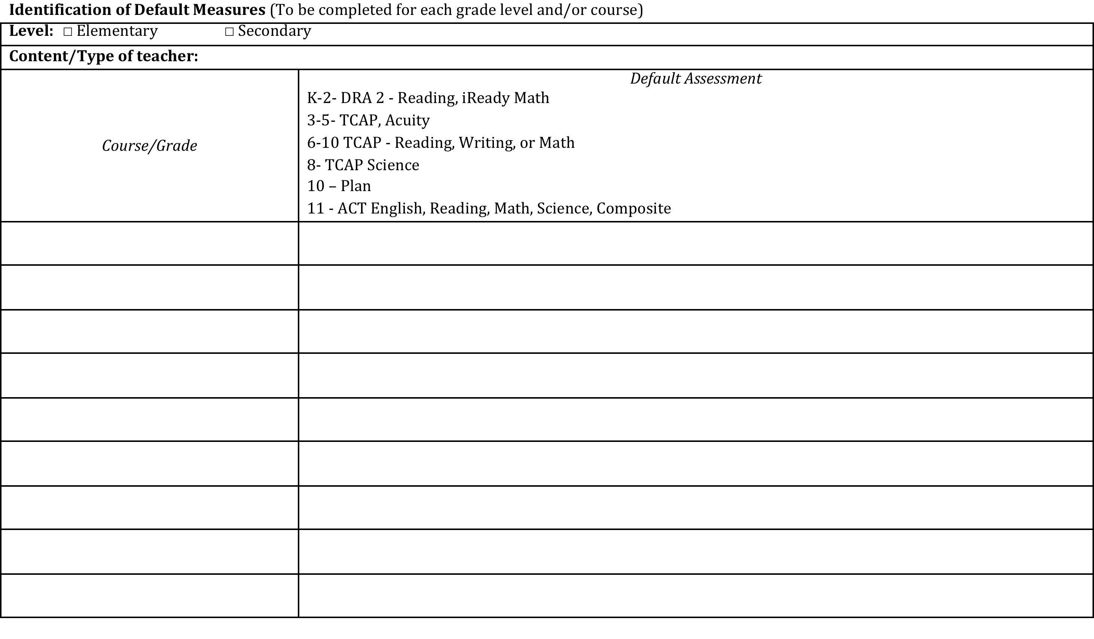
Default List

Slide 8
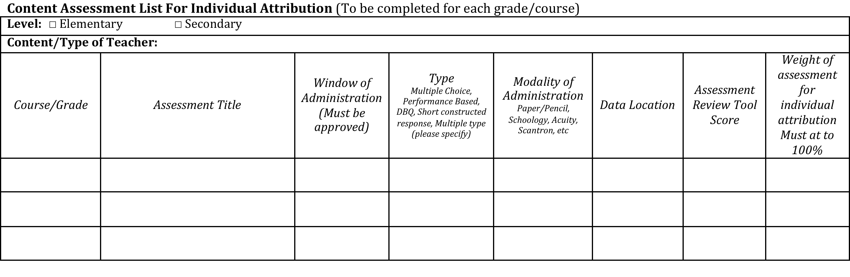
Content Assessment List

Slide 9
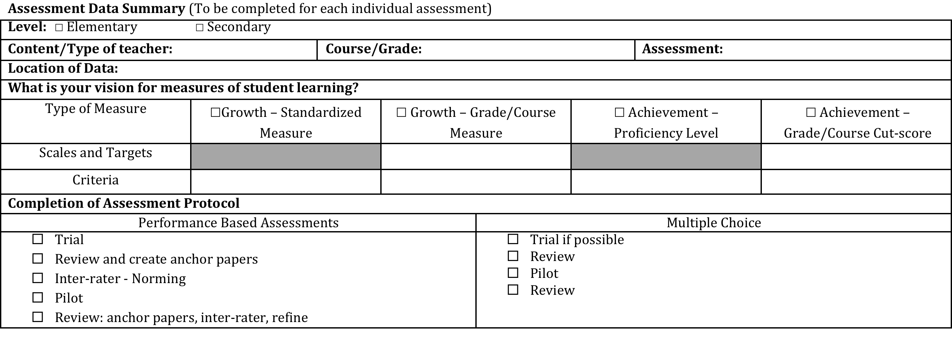
Assessment Data Summary

Slide 10
Measures of Student Learning
“Seeking to Ensure”
………all licensed personnel are evaluated using multiple, fair, transparent, timely, rigorous, and valid methods, fifty percent of which evaluation is determined by the academic growth of their students
“School Districts and BOCES shall seek to ensure that Measures of Student Academic Growth are”:
  Valid
  Reliable
  Comparable
SB-10-191
Notes:
This wording comes from the Law… the goal will be to have them define what that means and why its important… in this way they own the information

Slide 11
Measures of Student Learning
“Seeking to Ensure”
Brainstorm
  How do you know when an assessment is
    Fair
    Valid
    Reliable
    Rigorous
Notes:
Have on chart and record thinking. This can be used later to compare and contrast to the assessment review tool rational.
What criteria are we using to judge these elements against.

Slide 12
Measures of Student Learning
“Seeking to Ensure”
What resources exist to support us in this endeavor?
Notes:
Content Collaborative - reviewed
LDC -
AP exams and released items – need to be vetted against standards
Vetted: Published and aligned to a standard set (i.e. Textbook questions)
Authored questions: need to be vetted
Adjusted questions: depends on if structure

Slide 13
Assessment Support
Content Collaboratives
P-12 educators from around the state gathered to identify and create a high-quality assessment resource bank, which is aligned to the new Colorado Academic Standards and may be used in the context of Educator Effectiveness evaluations.
The Content Collaboratives, CDE, along with state and national experts, will establish examples of student learning measures within each K – 12 content area including:
Cohort I
Dance | Drama & Theatre Arts | Music | Reading, Writing and Communicating
Social Studies |  | Visual Arts
Cohort II
Physical Education | Science | World Languages | Comprehensive Health
Mathematics |  | CTE
Notes:
Possible usage with CC:
Assessment gaps that exist, these will help to fill in gaps.
Comparison/Starting point for local districts who may already have assessments in place

Slide 14
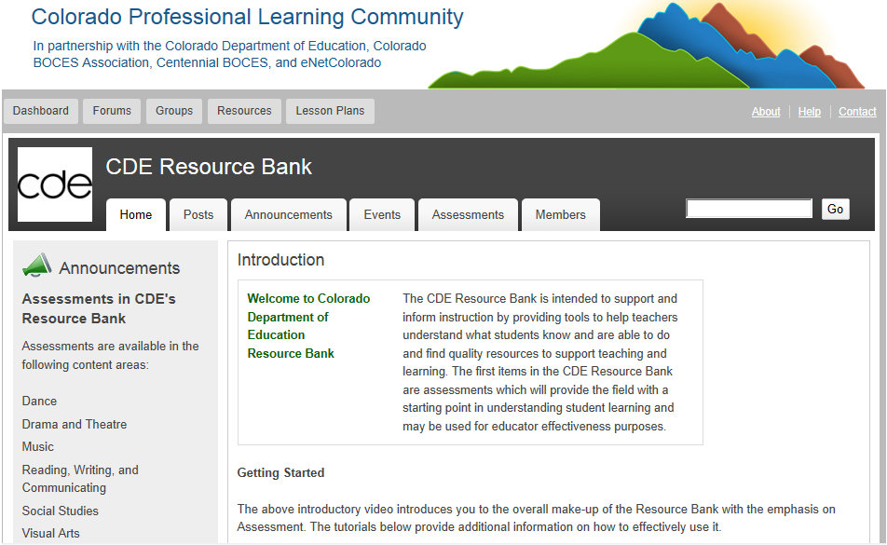
Notes:
Go to Actual Website – show how to get there and search etc.
http://www.coloradoplc.org/assessment

Slide 15
Assessment Review Tool
  Assessment Review Tool
Criteria used in this tool:
  Alignment
  Scoring
  Fair and Unbiased
  Opportunities to Learn
  How do these criteria support the idea of fair, valid, reliable, and comparable assessments?
Notes:
Alignment – In the process of evaluating assessments to measure student achievement, we want to ensure the assessments support the CAS and GLEs, including the DOK of the corresponding standards.
Scoring Guide – When measuring student learning there should be a fair and objective tool. Although scoring of constructed responses can be subjective, the clearer the scoring criteria are, the more reliable the scores will be. In addition, the inclusion of exemplars assists in reliable scoring of student work.
Fair and Unbiased – Measures of student learning should provide access and opportunity for all students, including students with disabilities, ELL, and GT students. By ensuring appropriate formatting, vocabulary and language, and accommodations all students are able to demonstrate their understanding of the concepts and skills.
Opportunities to Learn – Because we want assessments that will demonstrate student understanding, assessments should engage students in authentic situations that can be generalized to other content areas and other contexts. The information gained from the student work should allow teachers and parents to have a clear sense of students’ understanding of the learning expectations. In addition, assessment should clearly allow the teacher to know how to use the results to plan for the future instruction.
Click on the Final to show how it brings all the data together to make an informed decision.
Click on the assessment review tool to scan through the tabs.

Slide 16
Deeper Dive…….
True Collaborative Review
Objective: Understand how to use the Assessment Review Tool in a collaborative environment.
  Participants will work in teams to perform a collaborative review of each of the main elements of the assessment review tool.
  We will all perform an independent review of one of the “Fully Recommended” assessments.
  Split into an Alignment, Scoring, Fair and Unbiased, and Opportunities to Learn, Teams.
    Each team should have a fairly equal number of members
Each team will report out to the group at large and create a final collaborative version
Notes:
Strategically Group the teams so that each member of the build team is represented on a criteria team
Alignment and Scoring take priority.
Come together and share out on findings

Slide 17
Debrief/Reflection
How does the Assessment Review Tool help:
Create a useful process for teacher teams?
Serve as a teaching tool?
Act as a guide for creating assessments?
Impact the use of assessments in your classroom
Other?
Notes:
Record concerns/things to consider for next steps.

Slide 18
Where are you now?
On the wall you will see a chart that will be used to capture everyone’s level of comfort and knowledge with using a formal process to review assessments. Place a dot on the chart the best represents your level of comfort and knowledge now that we are near the end of the training.
Next
High Knowledge
Low Knowledge
Low Comfort
High Comfort

Slide 19

What are next next steps?
What would you like your assessment review and creation system to look like in 3 years?
What can you do this year in
order to get there?
Notes:
Are you ready to take the assessment through the tool or would you like to revise your assessments?

Slide 20

Assessment Inventory
Determine how student learning is currently measured in your content
  Conduct an assessment inventory to identify what is currently being used to measure student learning
  Identify where gaps exist

Slide 21
Assessment Data Summary
To be completed for each grade/course within your content
Growth data requires pre/post data
Cut-scores will be determined based on student data. District owns the average; teacher owns their contribution
Much Less than Expected
Less than Expected
Expected
More than Expected

Slide 22
Music Example
Stats from student data
Mean | 1.043103448
St. Dev | 1.557198199
Median | 1
Min | -6
1% | -3
5% | -1
10% | 0
20% | 0
25% | 0
30% | 0
40% | 1
50% | 1
60% | 1
70% | 2
75% | 2
80% | 2
90% | 3
95% | 4
99% | 5.73
Max | 9
Percentiles

Slide 23
Music Example
Cut scores
 | St. Dev Model |  | Quartile Model
More than expected | 1.56 | +1k St. Dev | 2 | 75 percentile
Expected | 0.52 | -1k St. Dev | 1 | 50 Percentile
Less than Expected | 0.0049 | -2k St Dev | 0 | 25 Percentile
Much less than Expected | 0 | Minimum | -6 | Minimum

Slide 24
Cut scores
 | St. Dev Model |  | Quartile Model
More than expected | 1.56 | +1k St. Dev | 2 | 75 percentile
Expected | 0.52 | -1k St. Dev | 1 | 50 Percentile
Less than Expected | 0.0049 | -2k St Dev | 0 | 25 Percentile
Much less than Expected | 0 | Minimum | -6 | Minimum
Teacher | Average Growth | Individual Attribution Rating
Teacher 1 | 1.019607843 | 2 | 2
Teacher 2 | 2.351351351 | 3 | 3
Teacher 3 | 0.987179487 | 2 | 1
Teacher 4 | 0.025 | 1 | 1
Teacher 5 | 0.896551724 | 2 | 1
Teacher 6 | 0.588785047 | 2 | 1
Teacher 7 | 1.220588235 | 2 | 2
Teacher 8 | 1.35 | 2 | 2
Teacher 9 | 0.604938272 | 2 | 1
Teacher 10 | 0.361445783 | 1 | 1
Teacher 11 | 2.810344828 | 3 | 3
Teacher 12 | 0.707692308 | 2 | 1
Teacher 13 | 1.274509804 | 2 | 2

