Slide 1
Literacy Design Collaborative
Session Three Training

Slide 2
Welcome to the Colorado Literacy Design Collaborative
Session Three Training
Notes:
Welcome and introduce presenters and teacher trainers. If this is the first time with a group, allow each presenter to provide background information.

Slide 3
Session III Outcomes
Deeper understanding and skill using the LDC Rubric to score student work
Construction of a carefully aligned module
Reflection on areas for further development
Reflection on today’s learning
Notes:
Discuss with participants that an aligned module flows from the overview to teaching task to student background and that the skills, mini-tasks, texts and resources support the teaching task to ultimately culminate in a writing product/outcome that connects with the intended purpose of the teaching task.

Slide 4
Where Am I Now with LDC?
Complete the hand-out, “I-Can” to self-assess where you are now
At the bottom of the hand-out, list the personal goals you have for today
Share with a partner
Identify priorities from table to share with whole group
Notes:
Handout: “I Can” Statements
Allow the participants five minutes to complete the self-assessment and write personal goals. Then, ask them to share at their tables. After a few minutes of discussion ask each table group to summarize their discussion.

Slide 5
Learning Targets
Improve understanding of the argumentation rubric by identifying key vocab for 2 of the elements
Develop common approach and vocabulary by scoring writing samples and discussing in groups
Notes:
This is the learning target for the next section of the presentation.

Slide 6
Paper X
Read Paper X on your own
Assign a score: A, B, C, D, or F
Place a post-it on the chart in the column that corresponds to your score
Notes:
Handout – Paper X. “Paper X” is student work. Consider using samples from “Anchor Papers for Mixed Module I” handout.
Without using a rubric (just your background knowledge) participants score Paper X.
A chart is posted on the wall and is divided into vertical columns A-B-C-D-F
Depending on the length of the paper, participants may need 5- 10 min. for this activity

Slide 7
Speak with your group and justify why you scored the way you did
Notes:
At table groups, discuss how you arrived at the grade you assigned to Paper X.

Slide 8
LDC Rubrics – Scoring
The LDC rubric is constructed for classroom use and to provide feedback to students and teachers. It is for feedback. It is not a summative rubric, as might be used in state exams to measure a set of absolute criteria.
Notes:
The next series of slides reviews some principles of scoring that will be helpful as we delve into deconstructing the rubric.

Slide 9
LDC Rubrics – Scoring
It helps students know expectations before the task is completed, and where their strengths and weaknesses are after the task is completed.

Slide 10
LDC Rubrics – Scoring
It helps teachers gauge the effectiveness of their instructional choices and delivery.

Slide 11
LDC Rubrics – Scoring
This rubric is designed for teaching that looks for progress NOT failure. No one fails. Students use the feedback to improve - as do teachers.

Slide 12
Holistic Scoring
Analytic Scoring
Based on general quality; balances the many characteristics to arrive at an overall score
Considers criteria separately giving a single score for each element

Slide 13
Principles of Scoring
Know the rubric
Trust evidence, not intuition
Match evidence to language in the rubric
Weigh evidence carefully – base judgment on the preponderance of evidence
Know your biases- leave them at the door

Slide 14
Principles of Scoring
Focus on what the student DOES, not what the student doesn’t do
Isolate judgment- one bad element doesn’t equal a bad paper
Resist seduction- one good element doesn’t equal a good paper
Recognize direct copy or plagiarism
Stick to the rubric

Slide 15
7 Scoring Elements
Focus
Controlling Idea
Reading/Research
Development
Organization
Conventions
Content Understanding
Notes:
Refer participants to scoring rubrics to review the 7 elements.

Slide 16
Unpacking & Understanding the Scoring Elements of the LDC Rubric
Notes:
Unpacking the elements of the rubric is an activity that is also worthwhile and necessary for students to understand and use the rubric.

Slide 17
What is the Purpose of the LDC Rubric?
Common scoring tool
Common language between teachers across contents
Common language between teachers and students
Feedback for students to improve literacy skills
To organize and construct meaning
Better communication of content knowledge comprehension

Slide 18
Defining the Elements
Read the definitions of the scoring elements
Discuss at your tables how these definitions add clarification to the LDC Rubric
Notes:
Handout – Definition of Informational and Argumentation Scoring Elements
Provide 5 minutes for this activity.

Slide 19
Scoring Element | ADVANCED (Exemplar)
FOCUS | Addresses all aspects of prompt appropriately with a consistently strong focus and convincing position.
CONTROLLING IDEA | Establishes and maintains a substantive and credible claim or proposal. (L2) Develops claims and counter claims fairly and thoroughly.
READING/ RESEARCH | Accurately and effectively presents important details from reading materials to develop argument or claim.
DEVELOPMENT | Presents thorough and detailed information to effectively support and develop the focus, controlling idea, or claim. (L3) Makes a clarifying connection(s) that illuminates argument and adds depth to reasoning.
ORGANIZATION | Maintains an organizational structure that intentionally and effectively enhances the presentation of information as required by the specific prompt. Structure enhances development of the reasoning and logic of the argument.
CONVENTIONS | Demonstrates and maintains a well-developed command of standard English conventions and cohesion, with few errors. Response includes language and tone consistently appropriate to the audience, purpose, and specific requirements of the prompt. Consistently cites sources using appropriate format.
CONTENT UNDERSTANDING | Integrates relevant and accurate disciplinary content with thorough explanations that demonstrate in-depth understanding.
Notes:
Ask participants to share portions of their discussion and ask for them to share where they may need more clarification prior to implementation.

Slide 20
Unpacking the Rubric
Based on the description of your element, list three to five specific observable traits of what would demonstrate its presence in a written assignment. (What will you see if this element is present?)
Draw a picture that represents the overall idea of the element.
Each team will share:
The element
An explanation of your picture for the element
An explanation of the three specific observable traits of that element
Notes:
Each designated team (or table) takes one element from the rubric (7 teams). Following the directions above, the team creates a visual that depicts the element. Participants will need markers and chart paper. 15 minutes for this activity from start to posting visuals. Each team appoints a spokesperson and briefly shares verbally related to their visual.

Slide 21
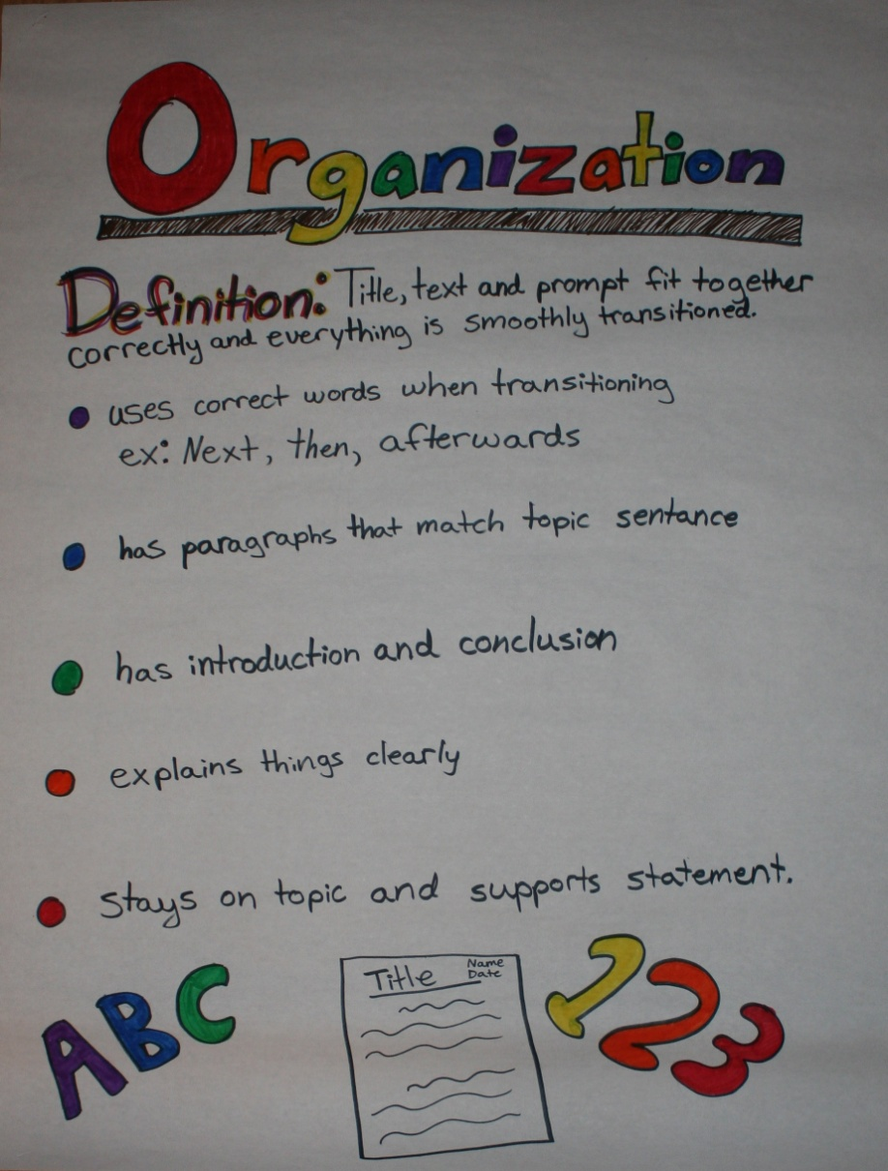
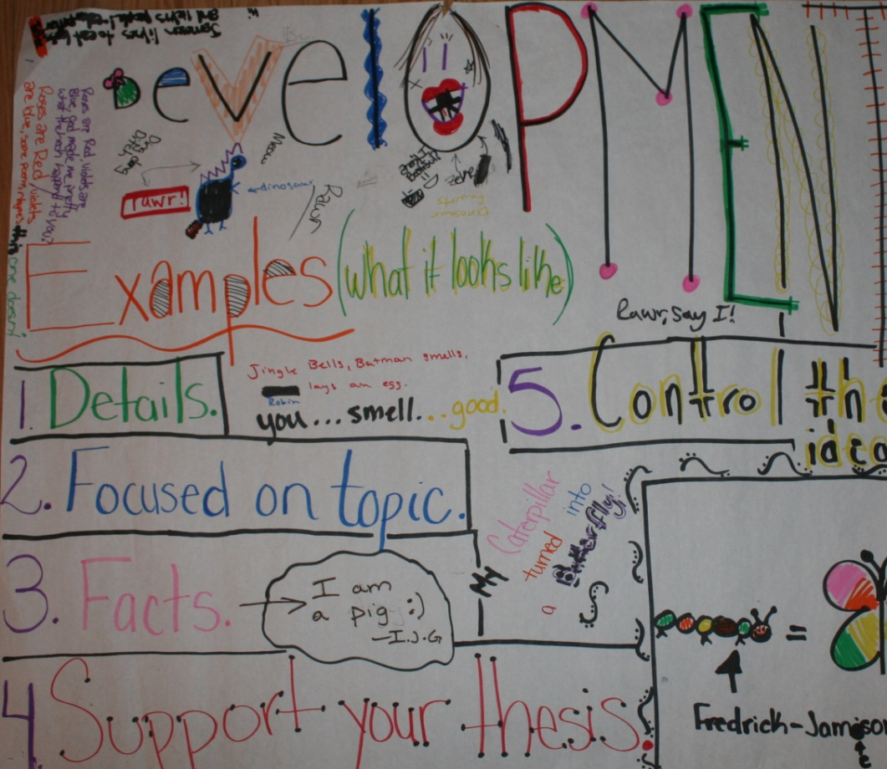
Student Examples
Notes:
These are examples of using a similar activity with students. Teachers posted the visuals and left them up in the classroom for students to view throughout the year.

Slide 22
Controlling Idea: Organization
Notes:
“Now, we are going to take a closer look at just one of the elements”.

Slide 23
Analytically Score Paper X for Controlling Idea
Be aware of your thought process
Notes:
Review, if necessary the guiding principles for scoring from the beginning of the presentation. Using Paper X again, score, using the rubric for controlling idea.

Slide 24
Share Scores
Come to agreement at your table on a score for controlling idea
Notes:
After each participant has completed their individual scoring they share and discuss at their table groups.
Have participants refer to these questions as they discuss.

Slide 25
Reflection on Scoring Process
Who disagreed?
Who was able to come to agreement?
How did you do it?
What was it like to negotiate/make your case?
Notes:
After each participant has completed their individual scoring they share and discuss at their table groups.
Have participants refer to these questions as they discuss.

Slide 26
Controlling Idea
Look at the CONTROLLING IDEA element on the rubric.
Highlight key vocabulary for proficient. What are the defining characteristics?
Notes:
Handout: LDC rubric (Argumentation and Informational)

Slide 27
Notes:
Ask participants to share key vocabulary and point to them on the slide.

Slide 28
Organization
Look at the ORGANIZATION element on the rubric.
Highlight key vocabulary for proficient. What are the defining characteristics?
Notes:
Repeat this process for the “organization” element

Slide 29
of the argument
Notes:
Ask participants to share key vocabulary.

Slide 30
Now, analytically score Paper X for organization.
Share out scores at the table.
Notes:
Score Paper X for the organization element and share discussion at table groups.

Slide 31
Organization: 2.5
Notes:
After participants have shared their scores, then share this score with them. This was the score given Paper X for organization by the team who submitted this anchor paper to the LDC Think Tank. This slide will need to change when the anchor paper is changed.

Slide 32
Reflect…..
What are the differences between how you arrived at the original letter grade and how you determined the scores for the two elements?
What if any biases did you notice in your thinking?
What type of feedback might you give to this student?
Notes:
Individual reflection on the question posed on the slide.

Slide 33
Paper Y
Controlling Idea & Organization
Notes:
Handout: Paper Y – If time allows and/or assess if the group needs more practice or is ready to move on.
Repeat the process used for Paper X and now score Paper Y for the two elements: controlling idea and organization.

Slide 34
Scoring Anchor Papers
Working individually, score the set of anchor papers you’ve been given.
Analytically for all elements
Holistic score for all elements
Be ready to share your scores with 3-4 others in your group
Discuss your differences and reach agreement
Compare your scores with the “official scores” that will be given to you when you’re done
Notes:
Handout: Anchor papers provided for scoring and Anchor paper annotation form
(We used middle school anchor papers downloaded from LDC Think Tank, but the anchor papers used may be dependent on the level taught by the participants)

Slide 35
Scoring Summary
After reading the “Definitions of Scoring Elements”, the Argumentation Rubric or the Information/Explanatory Rubric, and practicing scoring, write a brief explanation regarding why it is important to use the LDC rubric as it is written and not change it.
Notes:
Ask participants to do a “quick write” answering the question. If time allows, ask for volunteers to share responses.

Slide 36
Scoring Student Work
Break into groups of three by content
Score the student papers using the appropriate rubric
For each element, write a description, using language from the rubric, about why you scored it as you did (e.g., why was it a 2 or 2.5 and not a 3?)
Notes:
Handout: Annotated Scoring Sheet: (Have anchor papers available – sets of 3 – for those who don’t have student work.)
Prior to this session, participants were instructed to bring 3 sets of student work (high, medium, low) for a total of nine work samples. They should be using their own student work for this activity,. However, if they did not bring student work, they may join a group that has sufficient samples to review or the presenter’s will have surplus copies of student work to share.

Slide 37
Reflecting on Practice
Complete the Self-Reflection worksheet
On the back, write your story of how LDC has worked for you
This is your Exit Ticket for lunch
Notes:
Handout: Self- Reflection worksheet
The LDC stories were collected and shared with the Colorado Legacy Foundation staff for use on the LDC think tank and CLF web site. Sample “stories” currently exist on the LDC think tank and may be shared as models.

Slide 38
Speed-Dating with Mini-Tasks
Pick the most effective mini-task from your module
Write notes to yourself on the Mini-Task Template
In 5 minutes, share/exchange with another person
Switch pairs and share/exchange with a different person
Notes:
Handout: Speed Dating (mini-task)
In this activity we are switching gears from a focus on the rubric/scoring to going back and revising the participants’ work on their modules. Allow the participants at least 5 minutes to look at their module and choose an effective mini-task. Then, follow the directions on the slide to have them exchange ideas. If participants have a printed example of their mini-task, collect their examples for a “mini-task” bank that is being organized by the Colorado Consultants.

Slide 39
When Reviewing Your Teaching Task, Determine if it:
Is worthy of 2 - 4 weeks of instruction
Asks students to grapple with an important question
or topic
Provides opportunities to address text complexity
& the use of informational texts as indicated in the CCSS
Has students working in the most effective discourse/text
structure
Evolves from a rigorous text dependent question
Provides for an authentic audience
Training Tool
Notes:
Review teaching task elements and ask for questions or clarification on any of these statements.

Slide 40
Always double-check the teaching task you have chosen to determine that it is the correct one !
A Reminder

Slide 41
Reviewing and Aligning Modules
Goals of this session:
Review your module using the Informal Module Review/Alignment Chart
Identify changes you need to make in this module or in developing the next one so that it is aligned.
Refer to the handout, “Module Reminders!”
Refer to the Module Review and Feedback Form when needed.
Notes:
Handouts: Module Reminders & LDC Module Review Form
Request participants to use the handouts provided to complete a self-assessment of their module.

Slide 42
Reviewing your Module
Find a partner and each share your completed chart.
Notes:
Participants should share their self-assessment and also what they plan to modify during their work time today.

Slide 43
Writing Products
Review the materials in the packet on Writing Products
Examine your Teaching Task and identify what authentic product and audience you could use (not essay or report)
Complete this sentence: I chose ____________(writing product) because my task requires ____________ (type of writing) in _________________ (what discipline, e.g., ELA, SS, Sci)
Notes:
Handouts: Writing Products packet & Authentic Writing Products
The packet on writing products provides many ideas for authentic audiences.

Slide 44
A Final Task
After having participated in the LDC training sessions and reading the materials provided, write a “quick write” that describes what in your instructional practice will remain the same and what will be different. In addition, explain how these instructional decisions align with the expectations of the Colorado Teacher Evaluation Rubric. Cite examples from your recall of the training and materials.
Notes:
Collect the “quick write” samples as they will be used in conjunction with the LDC evaluation form to inform instruction.

Slide 45
Time to Work!
With the time left, either:
Revise one of your existing modules to reflect what you have learned today
Select a published module from MC and “clone” it, reflecting what you have learned today
Begin a new module, reflecting what you have learned today
Notes:
Depending on the skill level of the group, “cloning” a module using Module Creator may need to be demonstrated.
Typically, personal work that exceeds 1 – 1 1/2 hours may diminish in productivity. Judge the attention span of the group as it may be helpful to provide work time, bring them back together for reminders, demonstrations, instruction etc. Chunking work time often has the best outcome.

Slide 46
Self-Reflection
Go back to your “I-Can” statements from this morning and rate yourself based on where you are now
Your Quick Write and the completed Evaluation Form are your exit slips for today
Notes:
The “I Can” statements are for personal reflection.
The quick write and evaluation forms are collected.

